Slide 1
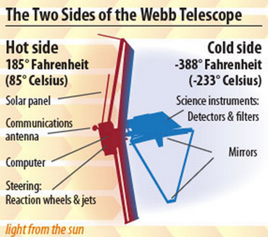
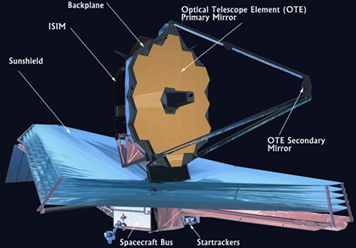
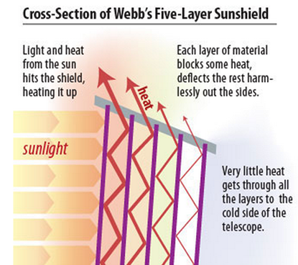
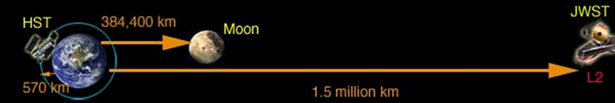
James Webb Space Telescope
James Webb telescope is a large infrared space telescope.
Consists of five main components ;
Near Infrared Spectrograph
Mid Infrared Spectrograph
Near Infrared Camera
“Tennis Court” sized sunshield
Large primary mirror.
Orbit 150 million km from earth at L2 (second Lagrange point).

Slide 2
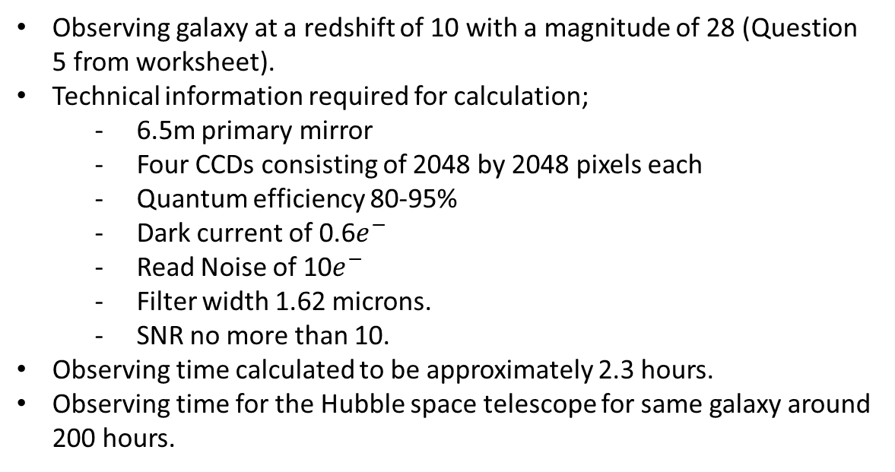
Calculation For Observing Time
Observing galaxy at a redshift of 10 with a magnitude of 28 (Question 5 from worksheet).
Technical information required for calculation;
- 6.5m primary mirror
- Four CCDs consisting of 2048 by 2048 pixels each
- Quantum efficiency 80-95%
- Dark current of 0.6$e^{−}$
- Read Noise of 10$e^{−}$
- Filter width 1.62 microns.
- SNR no more than 10.
Observing time calculated to be approximately 2.3 hours.
Observing time for the Hubble space telescope for same galaxy around 200 hours.

